Slide 1
Object- Oriented Programming (CS201)
Lecture 9
Object-Oriented Relationships

Slide 2
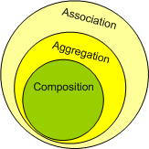



The four OOP Principles
Abstraction
Encapsulation
Association
Polymorphism
Object-Oriented Relationships
Association
UML symbol
Aggregation : has a
Composition: owns a
Inheritance : is a
Implementation : provides a

Slide 3
Implementing Object-Oriented Relationships : Association
association defines a relationship between classes of objects which allows one object instance to cause another to perform an action on its behalf...
Customer
purchase
Book
A customer can purchase a book
One way of implementation is by having object as a method argument
public class Book
{
private double price
double getPrice()
{
}
}
public class Customer
{
….
void purchase(Book book)
{
book.getPrice();
//////
}
…..
}
Notes:
or the creation of a local variable.

Slide 4
Example Association by passing objects as arguments
public class Customer{
private double purchaseAmount;
public void purchase(Book book)
{
purchaseAmount +=book.getPrice();
}
public double getPurchaseAmount()
{
return purchaseAmount ;
}
}
public class Book{
private double price;
private String title;
public Book(double price, String title)
{
this.price=price;
this.title=title;
}
public double getPrice()
{
return price;
}
public String getTitle()
{
return title;
}
}
public class Main{
public static void main(String [] args){
Customer cutomer1=new Customer ();
Book book1=new Book(100,”Java”);
Book book2=new Book(200,“C#”);
cutomer1. purchase(book1);
cutomer1. purchase(book2);
System.out.println(cutomer1.getPurchaseAmount());
}
}

Slide 5
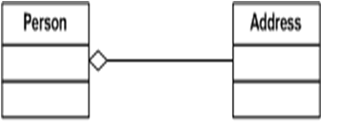
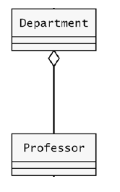
Aggregation
Aggregation is a type of association.
A connection between two objects where one has a field that refers to the other.
Aggregation is referred to as weak has a.
has a relationship is implemented by the having object as member variables
The lifetime of objects are not associated
“A person has a lawyer “
class Person
{
}
class Lawyer
{
public void sue()
}
“A department has a professor“
public class Person{
private Lawyer lawyer;
Person (Lawyer lawyer){ this.lawyer=lawyer;}
void m(){
lawyer.sue()
}
}
class Test
{
….
Lawyer mylawyer=new Lawyer ();
Person p1=new Person(myLawyer);
Person p2=new Person(myLawyer);
p1.m();
}
Notes:
When a class A contains references to a class B whose instances exist and are accessible outside of A, we say that A is an aggregation of B. For example, in a university software system, a Department class would contain references to Professor objects who are members of the department, but who also exist outside the department. In fact, a professor could be a member of two different departments. If A is an aggregation of B, we say that an A object “has a” B object. For example, a department has a professor.
Aggregation is a kind of association that specifies a whole/part relationship between the aggregate (whole) and component part. This relationship between the aggregate and component is a weak “has a” relationship as the component may survive the aggregate object. The component object may be accessed through other objects without going through the aggregate object. The aggregate object does not take part in the lifecycle of the component object, meaning the component object may outlive the aggregate object. The state of the component object still forms part of the aggregate object.
An example of aggregation is a History-Class object contains zero or more of Student objects. The state of each Student object has an influence on the state of the History-Class object. If the History-Class object is destroyed, the Student objects may continue to exist.

Slide 6
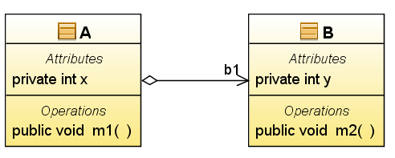
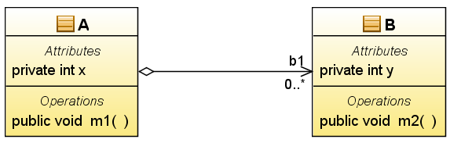
UML Representation for Aggregation
public class A {
private B b1;
private int x;
public void m1(){}
}
public class B {
private int y;
public void m2(){}
}
public class A {
private B [] b1;
private int x;
public void m1(){}
}
public class B {
private int y;
public void m2(){}
}

Slide 7
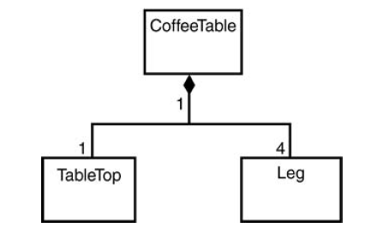


Composition
A composition is a strong type of aggregation.
Each component in a composite can belong to just one whole.
Composition defines the relation “owns a” / “part-of' relationship”/” strong has a”
The lifetime of objects are associated
The CoffeeTable owns 4Leg
A house owns a room
public class Car
{
Engine e;
e=new Engine();
}
public class Engine
{
}
Notes:
The symbol for a composite is the same as the symbol for an aggregation except
the diamond is filled, as shown
The lifetime of the part (Engine) is managed by the whole (Car), when Car is destroyed, Engine is destroyed along with it.

Slide 8
Case Study : Voting System
Design a software for a simple voting system using 2 classes :class Voting & class Citizen
Each Voting has a title and variables representing accept count (acceptCount) and refuse count (refuseCount)
Each object of class Voting is initialized using the title of the Voting .
Class Voting has the following methods :
accessor method for the title, acceptCount and the refuseCount fields.
method incrementAcceptCount() : increase the accept count for the Voting
method incrementRefuseCount (): increase the refuse count of the Voting
method boolean checkAcceptance () : if the accept counts are more than the refused count return true otherwise return false
Each citizen has a name and a boolean field (eligible)representing whether he is eligible to vote or not , each citizen also has a Voting.
Each object of class citizen is initialized using the name of citizen and the Voting .
Class Citizen has the following methods :
accessor and mutator methods for eligible field.
accessor method for the name field.
method voteFor() : check eligibility and then increase the accept count for the Voting .
method voteAgainst(): check eligibility and increase the refuse count of the Voting .
( a citizen can vote only once)
Notes:
A data field of a class can be of type reference

Slide 9
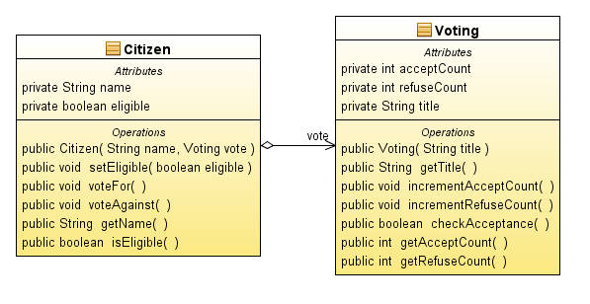

Slide 10
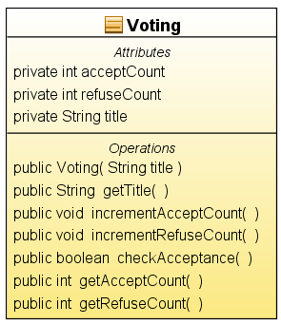
public boolean checkAcceptance()
{
if (acceptCount>refuseCount)
return true;
else
return false;
}
public int getAcceptCount()
{
return acceptCount;
}
public int getRefuseCount()
{
return refuseCount;
}
}
public class Voting
{
private int acceptCount;
private int refuseCount;
private String title;
public Voting(String title)
{
this.title=title;
}
public String getTitle()
{
return title;
}
public void incrementAcceptCount()
{
acceptCount++;
}
public void incrementRefuseCount()
{
refuseCount++;
}

Slide 11
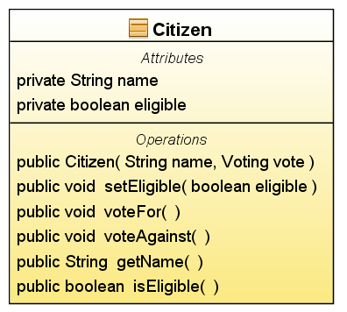
public class Citizen
{
private String name;
private boolean eligible;
private Voting vote;
public Citizen(String name,Voting vote)
{
this.name=name;
this.vote=vote;
}
public void setEligible(boolean eligible)
{
this.eligible=eligible;
}
public void voteFor()
{
if(eligible)
vote.incrementAcceptCount();
eligible=false;
}
public void voteAgainst()
{
if(eligible)
vote.incrementRefuseCount();
eligible=false;
}
public String getName()
{
return name;
}
public boolean isEligible()
{
return eligible;
}
}

Slide 12
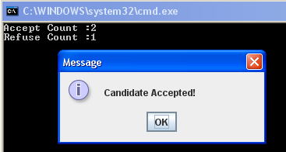
import javax.swing.JOptionPane;
class VoteTest
{
public static void main (String [] arg)
{
Voting vote1=new Voting("Presdintal Vote");
Citizen c1=new Citizen("Ahmed Hussien",vote1);
Citizen c2=new Citizen("Akrum Ahmed",vote1);
Citizen c3=new Citizen("Ahmed Moamed",vote1);
c1.setEligible(true);
c2.setEligible(true);
c3.setEligible(true);
c1.voteFor();
c2.voteFor();
c3.voteAgainst();
System.out.println ("Accept Count :"+vote1.getAcceptCount());
System.out.println ("Refuse Count :"+vote1.getRefuseCount());
boolean flag=vote1.checkAcceptance();
if (flag)
JOptionPane.showMessageDialog(null, "Candidate Accepted!");
else
JOptionPane.showMessageDialog(null, "Candidate Refused!");
}
}

Slide 13
CS243 Object Oriented Programming
Dr Walid M. Aly
Tutorial
Case Study : Students registered in a course

Slide 14
Design a simple registration system that allows Student to register in a course using 2 classes :class Student & class Course
Each student has a name and an id variables.
Each object of class Student is initialized using values of name and id passed to constructor.
Class Student has accessor methods for its instance variables
Each Course has a name, and a variable numberOfStudent representing the number of registered students, a Course can have a maximum number of 10 students registered in it .
Class course store the registered students in students which is an array of type Student, when a student register in a course , he is added to the array.
Each object of class Course is initialized using the title.
Class Course has the following methods :
Method boolean isFull() , return true if the course is full .
accessor method for the title and numberOfStudent field.
method register Student(Student student): if the course is not full, register a student in course
Notes:
A data field of a class can be of type reference

Slide 15
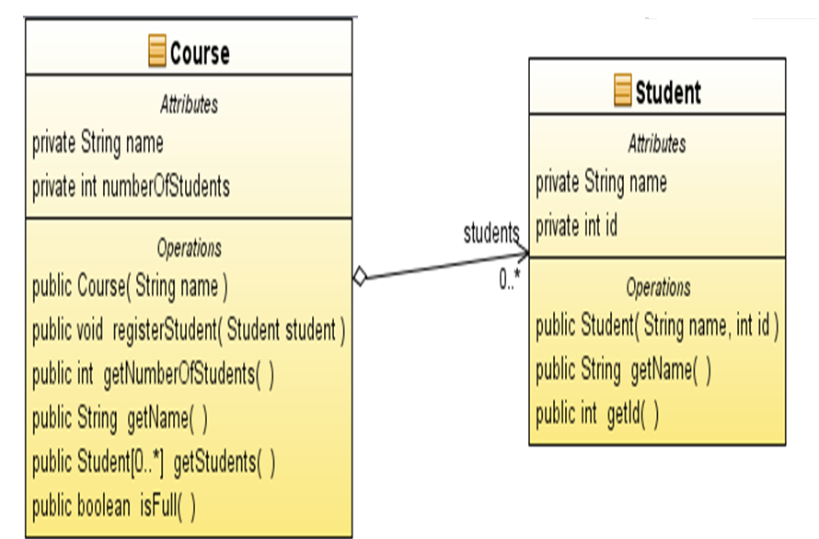

Slide 16
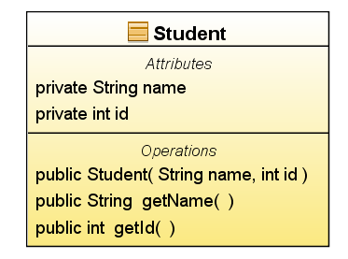
public class Student {
private String name;
private int id;
public Student(String name,int id)
{
this.name=name;
this.id=id;
}
public String getName()
{
return name;
}
public int getId()
{
return id;
}
}

Slide 17
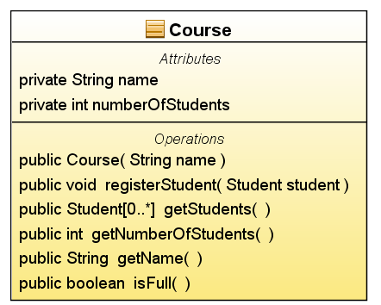
public class Course {
private String name;
private Student[] students = new Student[10];
private int numberOfStudents;
public Course(String name) {
this.name = name;
}
public void registerStudent(Student student) {
if (isFull())
{
return;
}
students[numberOfStudents] = student;
numberOfStudents++;
}
public int getNumberOfStudents() {
return numberOfStudents;
}
public String getName() {
return name;
}
public Student[] getStudents() {
return students;
}
public boolean isFull()
{
if (numberOfStudents==10)
return true;
else
return false;
}
}

Slide 18
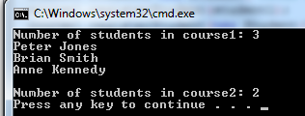
public class Test{
public static void main(String[] args) {
Course course1 = new Course("Data Structures");
Student student1=new Student("Peter Jones",4);
course1.registerStudent(student1);
course1.registerStudent(new Student("Brian Smith",7));
course1.registerStudent(new Student("Anne Kennedy",9));
Course course2 = new Course("Database Systems");
course2.registerStudent(student1);
course2.registerStudent(new Student ("Steve Smith",7));
int num1= course1.getNumberOfStudents();
System.out.println("Number of students in course1: " +num1);
Student[] students = course1.getStudents();
for (int i = 0; i < course1.getNumberOfStudents(); i++){
String name=students[i].getName() ;
System.out.println(name);
}
System.out.println();
System.out.println("Number of students in course2: " + course2.getNumberOfStudents());
}
}

